Slide 1
Introduction to Python Programming
Practice

Slide 2
Why Python Programming?
Python is a very popular general-purpose interpreted, interactive, object-oriented, and high-level programming language.
It is a dynamically-typed and garbage-collected programming language.
It was created by Guido van Rossum during 1985- 1990.
Python supports multiple programming paradigms, including Procedural, Object Oriented and Functional programming language.
Python design philosophy emphasizes code readability with the use of significant indentation.

Slide 3
Features of Python programming language
Features of Python
Readable
Easy to learn
Free
Memory Management
Open Source
Exception Handling
Large Standard Library

Slide 4
What Can You Do with Python?
Web Development
Machine Learning
Data Analysis
Scripting
Game Development

Slide 5
Python IDEs and Code Editors
IDLE
Jupyter Notebook
Spyder
Atom
Visual Studio Code
Sublime Text
PyCharm
Eclipse

Slide 6
Advantages of learning Python
Python is Interpreted
Python is Interactive
Python is Object-Oriented
Python is a Beginner's Language
Python is processed at runtime by the interpreter. You do not need to compile your program before executing it. This is similar to PERL and PHP.
You can actually sit at a Python prompt and interact with the interpreter directly to write your programs.
Python supports Object-Oriented style or technique of programming that encapsulates code within objects.
Python is a great language for the beginner-level programmers and supports the development of a wide range of applications from simple text processing to WWW browsers to games.

Slide 7
Some companies Using Python
Google
Intel
NASA
PayPal
Facebook
IBM
Amazon
Netflix
Pinterest
Uber

Slide 8
ANACONDA (Python distribution)
Anaconda is a distribution of the Python and R programming languages for scientific computing (data science, machine learning applications, large-scale data processing, predictive analytics, etc.), that aims to simplify package management and deployment.
Anaconda Navigator is a desktop graphical user interface (GUI) included in Anaconda distribution that allows users to launch applications and manage conda packages, environments and channels without using command-line commands.

Slide 9
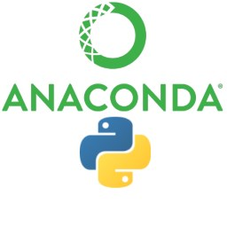
Installing on Windows
Download Anaconda >>
https://docs.anaconda.com/anaconda/install/windows/

Slide 10
Installing on MacOS
Download Anaconda >>
https://docs.anaconda.com/anaconda/install/mac-os/

Slide 11
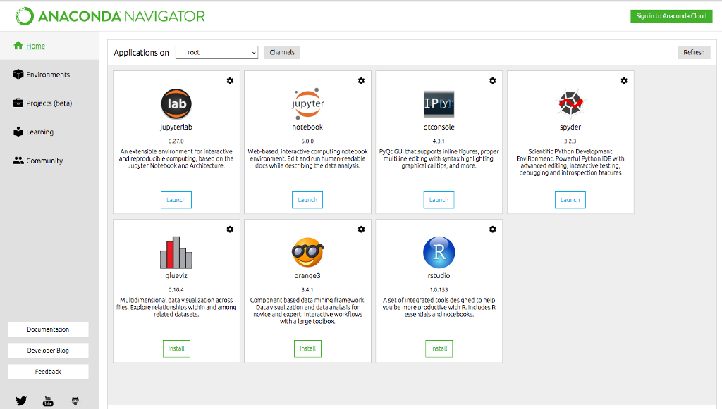
ANACONDA IDE

Slide 12
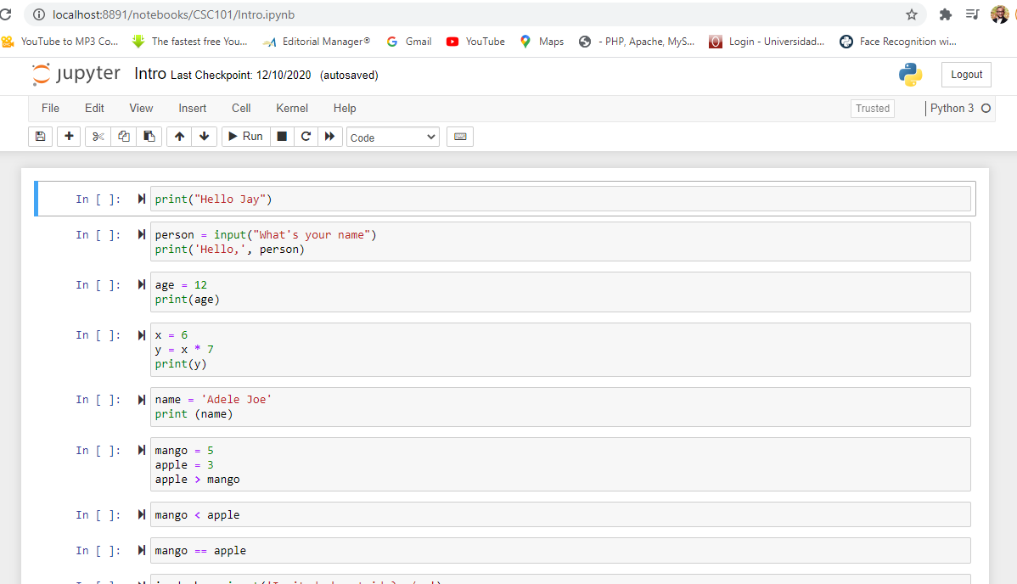
Jupyter Notebook

Slide 13
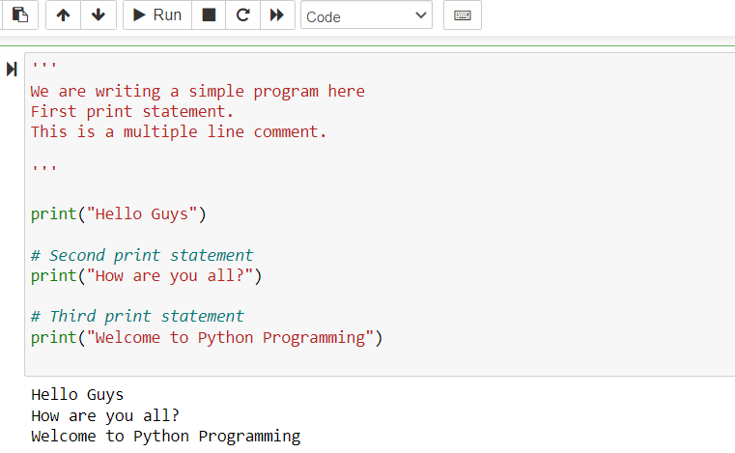

Best Programming Practices
Commenting & documentation

Slide 14
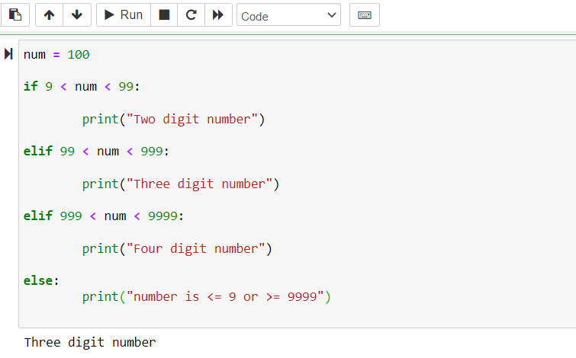
Best Programming Practices
Consistent Indentation

Slide 15
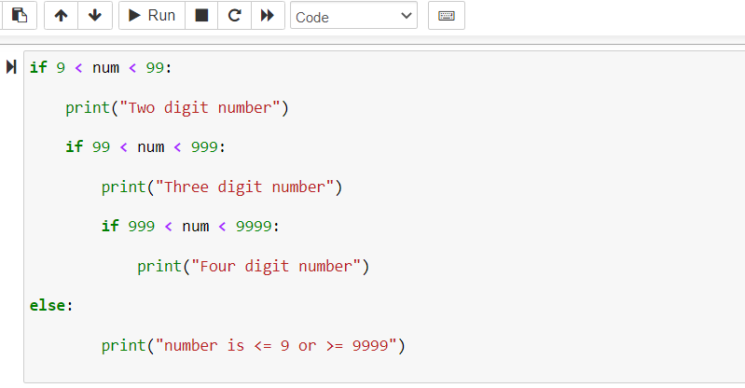
Best Programming Practices
Avoid Deep Nesting

Slide 16
Best Programming Practices
Follow the DRY Principle
DRY stands for “Don’t Repeat Yourself.
The same piece of code should not be repeated over and over again.
File and Folder Organization
You should avoid writing all of your code in one of 1-2 files.
It break your app but it would be a nightmare to read, debug and maintain your application later.
Keeping a clean folder structure will make the code a lot more readable and maintainable.

Slide 17
Python Variables with examples
Variable name is known as identifier. There are few rules that you have to follow while naming the variables in Python.
The name of the variable must always start with either a letter or an underscore (_). For example: _str, str, num, _num are all valid name for the variables.
The name of the variable cannot start with a number. For example: 9num is not a valid variable name.
The name of the variable cannot have special characters such as %, $, # etc, they can only have alphanumeric characters and underscore (A to Z, a to z, 0-9 or _ ).
Variable name is case sensitive in Python which means num and NUM are two different variables in python.

Slide 18
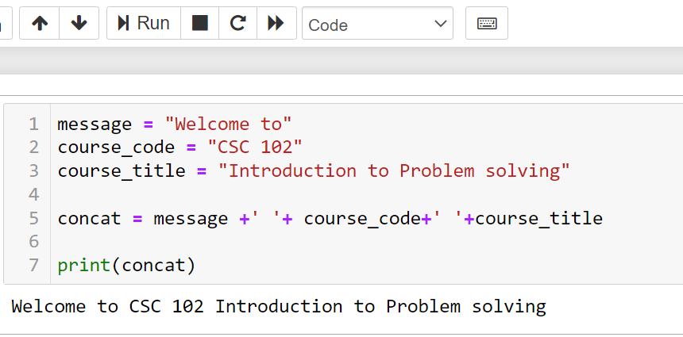
Python String Variable
Enter the code in the cell block and press the Shift + Enter key

Slide 19
Python Data Types
A data type defines the type of data, for example:
123 is an integer data,
“hello” is a string data type,
2.33 is a float data type
The data types in Python are divided in two categories: 1. Immutable data types – Values cannot be changed. 2. Mutable data types – Values can be changed

Slide 20
Python Data Types
Immutable data types in Python are: 1. Numbers 2. String 3. Tuple
Mutable data types in Python are: 1. List 2. Dictionaries 3. Sets

Slide 21
Python Keywords and Identifiers
A Python keyword is a reserved word which you can’t use as a name of your variable, class, function etc.
These keywords have a special meaning and they are used for special purposes in Python programming language. For example – Python keyword “while” is used for while loop thus you can’t name a variable with the name “while” else it may cause compilation error.
There are total 33 keywords in Python 3.6.

Slide 22
Python Keywords and Identifiers
Here is a list of the Python keywords.
False def if raise
None del import return
True elif in try
and else is while
as except lambda with
assert finally nonlocal yield
break for not class
from or continue global
pass

Slide 23
Laboratory Practice

Slide 24
Create a GitHub Repository
goto: https://github.com
Log into your GitHub
Create your Repository
Create Repo Name: dmoru883/desmondCSC102
Open My Document from CMD Line
Clone Repo: git clone <https…>
Commit Repo: git commit –m”Message”
Push Repo: git push
Create a folder Week_1 inside cloned repo
Save your codes inside this folder

Slide 25
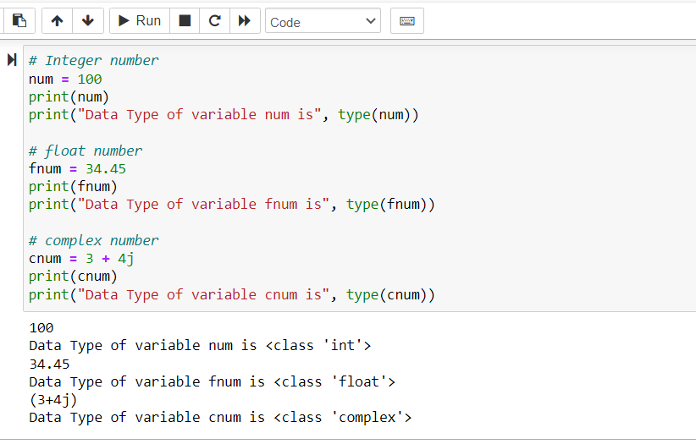
Numeric Data Type in Python
Week_1/practice_1.pynb
To run code: shift + enter

Slide 26
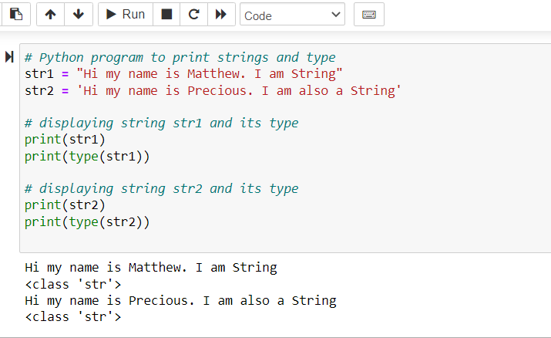
Python Data Type – String
Week_1/practice_2.pynb

Slide 27

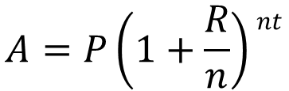

Class Project
Design a flowchart and write a python program for the following problems:
a) Simple Interest:
b) Compound Interest:
c) Annuity Plan:
$$A=P\left(1+(\frac{R}{100})T\right)$$
$$A=P\left(1+\frac{R}{n}\right)nt$$
$$A=PMT x\frac{\left[\left(1+\frac{R}{n}\right)nt −1\right]}{(\frac{R}{n})}$$

